Slide 1
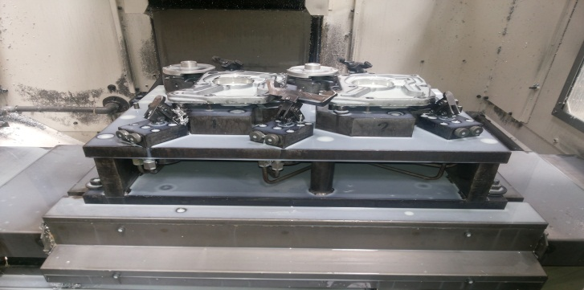
P15
TPM CIRCLE NO :- 01
ACTIVITY
KK
QM
PM
JH
SHE
OT
DM
E&T
KAIZEN IDEA SHEET
TPM CIRCLE NAME: Achiever
LOSS NO. / STEP
DEPT :- MACHINE SHOP
RESULT AREA
P
Q
A
B
C
D
S
M
CELL:- A105 FL WT
CELL NAME:- oil pump
MACHINE / STAGE :-
OPERATION :-
KAIZEN THEME:- To reduce set up time
IDEA :-To used standard size Allen bolt for fixture setup
PROBLEM PRESENT STATUS –Four side locate different bolt and that causes time consume getting Allen key and spanner
COUNTERMEASURE:-
1.Required more time for change fixture set up
BENCHMARK
MINOR
TARGET
0
KAIZEN START
15.08.2016
TDC
26.08.2016
KAIZEN FINISH
26.08.2016
TEAM MEMBERS :KESHOR PAWAR,
MARUTI PATIL
BENEFITS :-
INCREASES PRODUCTIVITY
Before
After
KAIZEN SUSTENANCE
WHY - WHY ANALYSIS :-
Why1 :- four different type of bolt for different four side
Why2 :- use different instrument (L key & planner )
Why3 :- Required more time
Why4 :- minor break down in shift time
RESULT : Less time required for fixture set up
WHAT TO DO:
HOW TO DO:-
FREQUENCY :- Daily.
SCOPE & PLAN FOR HORIZONTAL DEPLOYMENT
Sr No | CELL | TDC | RESP. | STATUS
1
2
ROOT CAUSE : Time saving
REGISTRATION NO. & DATE : 15.08.2016
REGISTERED BY :- Umesh pimple
MANAGER’S SIGN :- D Y . Pawar
1

